Slide 1
Building an AI Research Assistant
B!gThinkAI Pyoneer Meeting

Slide 2
The Four Horsemen of our AI Research Agent
1 - Prompt Engineering for formatting efficient data
2 - RAG for enhancing prompts with context
3 - LangChain for efficiently formatting our RAG pipeline
4 - Unsloth FastLanguage model for LLM inference

Slide 3

Prompt Engineering - Why?
LLMs don’t know what you want!
Good prompts = Better answer
Ex:
“Bitcamp Workshops” vs “List out all Bitcamp workshops from 9am to 12am on Saturday 4/12/2025, organized by title, date, description and store all in a JSON format”
Specify output format, exact dates, act in a specific manner

Slide 4
Why this works - The Tech side
Tokenization
Model Parameters
Model Architectures
Loss functions and gradients

Slide 5

RETRIEVAL-AUGMENTED GENERATION
RAG = External knowledge base + LLM Generation
Why is this important? LLMs only exist in context and for accurate results we want targeted context
LLMs will start hallucinating!
Unlike keyword search, RAG uses vector search to understand semantic meaning of text
RAG:
DATA
YOUR LLM

Slide 6
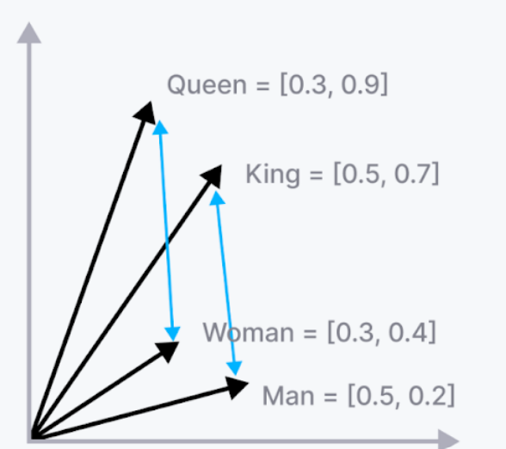
Vector Embeddings in RAG systems
Embeddings = Representing text as vectors
Words with similar semantic meanings have “closer” vectors
RAG performs a k-nearest neighbors search to gather related vectors
https://cdl-demo-xi.vercel.app/embeddings_viz.html

Slide 7
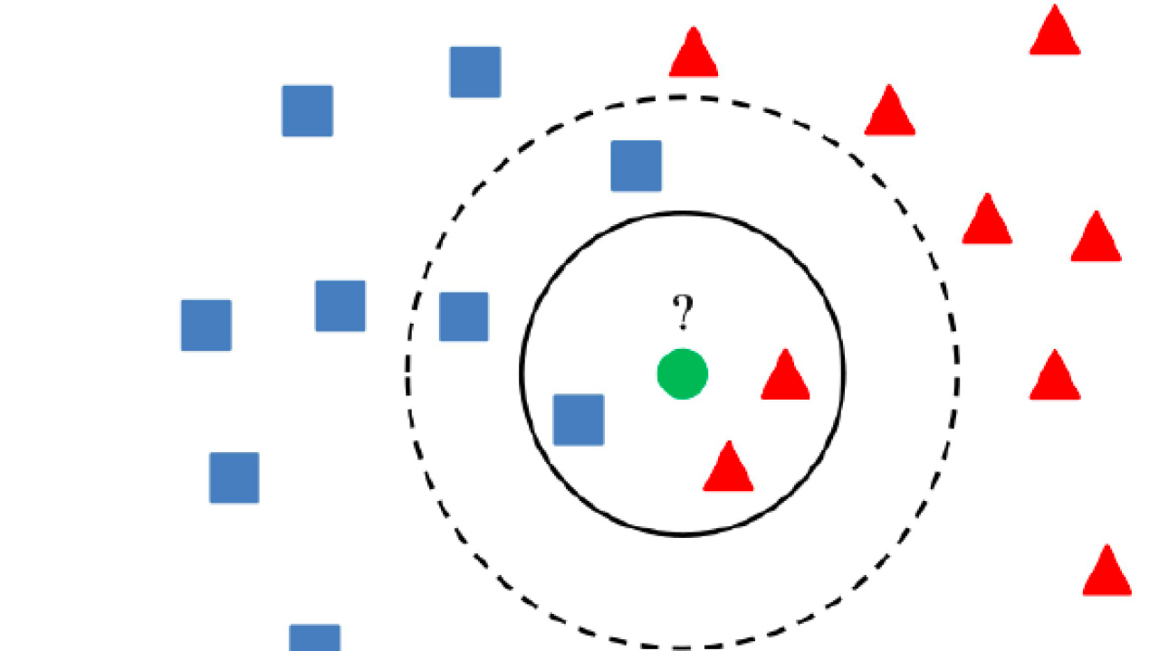
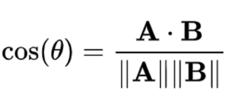
K-Nearest Neighbors
The algorithm’s goal is to categorize new points based on existing clusters
Algorithm steps:
1 - Find k-nearest points to our
new data
2 - Take their weighted avg of labels based on distance
3 - Assign label
For our vector database, this is calculated using cosine similarity:
Now we have our top k-chunks!

Slide 8
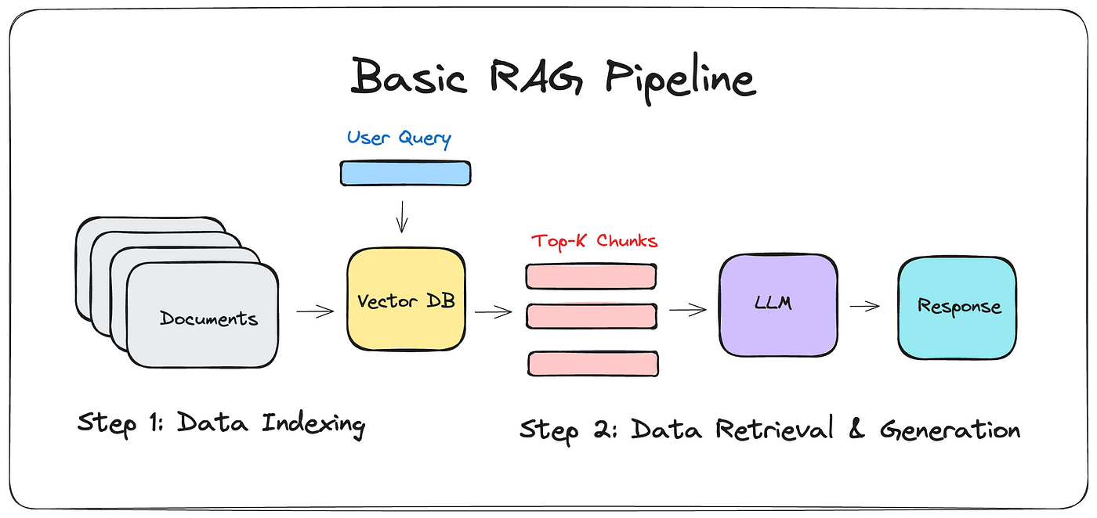
R

Slide 9
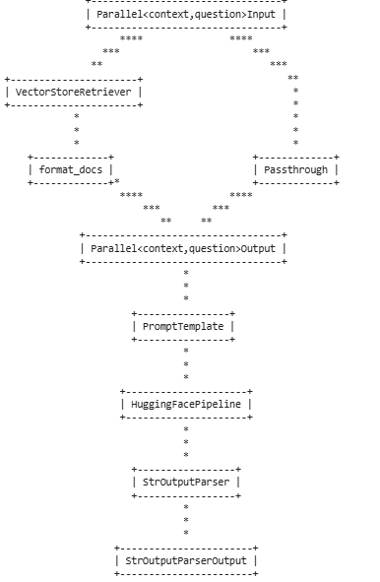
LangChain Chains
The distinct steps performed by the RAG pipeline to answer the user's query:
Decomposing the initial question into sub-questions.
Searching the Milvus vector database for relevant documents from Wikipedia.
Retrieving the top-k matching documents.
Prompting the DeepSeek language model with the retrieved context and the (sub-)question.
Generating an answer based on the provided information.
Synthesizing the individual answers into a final report.

Slide 10
What We're Using Today - Key Libraries
FastLanguageModel (Unsloth):
Significantly speeds up and reduces memory usage for the core reasoning model (DeepSeek), making efficient RAG possible.
Focused on low-RAM, high-speed, GPU-efficient deployment of 7B-13B models
GREAT FOR RAG MODELS!!!
Milvus (via LangChain):
A high-performance vector database enabling fast and accurate retrieval of relevant information from the Wikipedia knowledge base based on semantic similarity.

Slide 11
What We're Using Today - Key Libraries
LangChain:
The framework that orchestrates the entire Retrieval-Augmented Generation process, connecting the language model, vector database, and data processing steps.
Sentence Transformers (via LangChain):
Used to create meaningful vector embeddings of the Wikipedia content, which allows Milvus to perform effective semantic search.

Slide 12
Resources
https://www.datacamp.com/blog/what-is-prompt-engineering-the-future-of-ai-communication
https://aws.amazon.com/what-is/retrieval-augmented-generation/
https://www.geeksforgeeks.org/k-nearest-neighbours/
https://www.techtarget.com/searchenterpriseai/definition/LangChain
https://skillcrush.com/blog/intro-to-langchain/
https://huggingface.co/blog/Andyrasika/finetune-unsloth-qlora
https://docs.unsloth.ai/basics/running-and-saving-models/inference
https://milvus.io/blog/i-built-a-deep-research-with-open-source-so-can-you.md

Slide 13
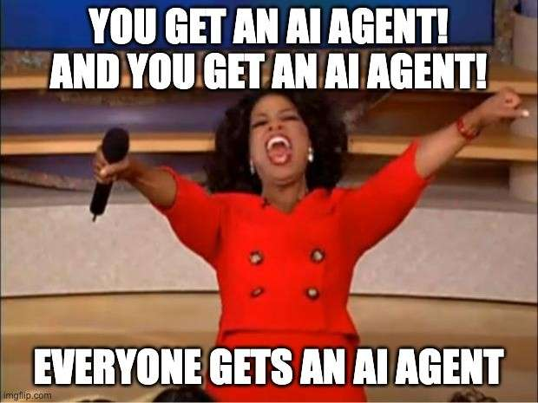
Now on to the fun part!
https://tinyurl.com/bigthinkw2

Slide 14
Potential research topics
query = "How has climate change impacted global biodiversity over the last 50 years?"
page_title = "Climate change and biodiversity"
topic = "The influence of global climate change on biodiversity patterns, species extinction rates, and ecosystem disruption."
q = "What are the key species most affected by climate change?"
query = "Why has dystopian fiction become more popular in recent decades?"
page_title = "Dystopian fiction"
topic = "The cultural and historical factors behind the growing popularity of dystopian literature in the 21st century."
q = "How have themes in dystopian literature evolved over time?"

Slide 15
Potential research topics ctd.
query = "What makes internet memes go viral?"
page_title = "Internet meme"
topic = "The cultural and psychological factors that influence the virality of internet memes."
q = "What are the defining features of a viral meme?"
query = "Why haven't we found alien life yet?"
page_title = "Fermi Paradox"
topic = "The paradox of high probability for extraterrestrial life and our lack of evidence or contact so far."
q = "What are the most popular theories explaining the Fermi Paradox?"
query = "How does ranked-choice voting influence election results and voter engagement?"
page_title = "Ranked voting"
topic = "The implementation and consequences of ranked-choice voting in different democracies."
q = "Which countries or regions have adopted ranked-choice voting and how has it impacted politics?"

